Slide 1

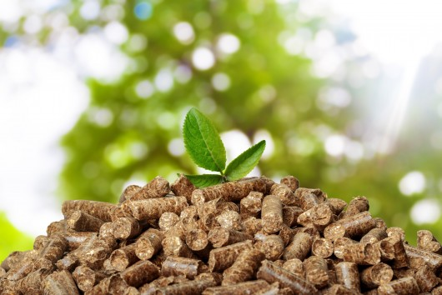
Building a Greener Economic Environment
Wood biomass and the circular economy
Regional experience
DRAGANA DJUKIC, Representative Serbia
August 2018

Slide 2
About CNVP
Is a Dutch-registered CSO.
Has registered branch offices in Albania, Kosovo, Macedonia, Montenegro, Serbia and Bosnia-Herzegovina.
Employs 28 people who are supported by a wide range of specialist Associate Experts and graduate interns.

Slide 3
Key CNVP skills:
Has an international reputation as a facilitator, using tried and tested analytical, consulting, advisory, coaching, mentoring, demonstration and knowledge transfer skills to achieve long-term sustainability of development activities.
Implements donor-funded projects at central level (in ministries of agriculture, forestry, rural development and environment), as well as at municipality and community levels.
Has a strong Western Balkans’ perspective that helps it to design, implement and facilitate in-country, cross-border and regional projects.

Slide 4
Six key areas of CNVP capacity strengthening:
Sustainable forest management
Climate change, environment and NRM
Agri-rural development, including sustainable zonal coast management
Renewable energy and waste management
Community mobilisation, governance and civil society
European accession and related policy questions

Slide 5
Major projects under implementation:
Forests for Local Economic Development (2014-18), Albania, Sida funding
Development of Tourism in Diber Region, Albania, USAID/Sida funding
Strengthening Sustainable Private and Decentralized Forestry (2014-20), Kosovo, Sida funding
National Rural Parliament, Macedonia, EU funding
Rural Youth and EU Integration, Macedonia, EU funding
Communities Communicating Climate Change, Macedonia, EU funding
CSOs Driving Rural Development, Montenegro, EU funding

Slide 6
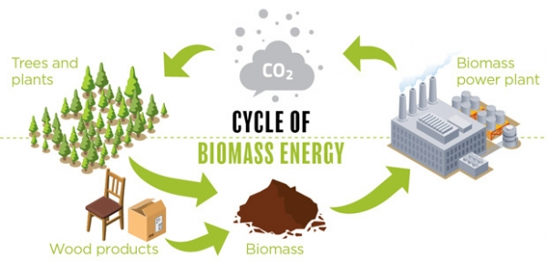
Wood biomass as renewable energy source
industryandbusiness.ca

Slide 7
About wood biomass
Large amount of biomass used today for production of energy and heat comes from wood:
  Wood residues in forests
  Fuel wood
  Residues in wood processing industry
  Fast-growing plantations
  Urban biomass
Wood fuel: Logs, pellets, briquettes, wood chips

Slide 8
Benefits of using wood biomass
Contributes to reduction of CO2 emissions in the atmosphere i.e. the green house effect
Reduces dependence on imports of fossil fuels
Operating costs can be cheaper than for fossil fuels
Enhances living conditions
Contributes to economic and rural development

Slide 9
European Union
Current EU Renewable Energy Directive sets a binding target of 20% final energy consumption from renewable sources by 2020, with at least 10% of transport fuels coming from renewable sources.
EU countries agreed in 2014 to achieve at least 27% from renewable sources of EU’s final energy consumption by 2030.
On 14 June 2018, a 32% binding renewable energy target for the EU was agreed for 2030, with a clause for upward revision by 2023.
Public interventions e.g. support schemes are necessary to make renewable energy technologies competitive, but should not distort energy prices and the energy market.
Biomass (including forest waste and residues) accounts for about two-thirds of all renewable energy consumption in the EU.
Sustainability seeks to maximise the benefits of using biomass whilst avoiding negative impacts on the environment e.g. illegal cutting.

Slide 10
Western Balkans
Common context and obstacles
Imported and expensive energy, mostly fossil fuels
Traditionally high consumption of fire wood
Underdeveloped (wood) biomass market
Informal market and illegal logging

Slide 11
Albania
Target of Renewable Energy Resources by 2020 is 38%
Hydropower, wind energy, solar energy: 25%
Biomass: 10%
Biofuels: 3%
Theoretical potential of biomass to contribute to energy balance:
Forests: 1.07%
Biomass from seed/ fruits/agr. production: 4.45%
Urban waste: 5.80%
Waste from fruit trees: 0.65%
Cattle waste: 2.37%
Power plants: 0.26%
Total 14.6%

Slide 12
Albania - wood biomass
Challenges:
Forests cannot provide current needs; demand for pellets higher than supply; capacities of pellet companies up to 3 times higher than production, because of lack of materials
Marketing of fuelwood/wood largely informal, up to 80-90%
Moratorium - logging from all forest areas banned for 10 years
Cleaning and thinning operations; former operations left about 30% of biomass in the forest
Opportunities:
Ministry of Environment supports the use of central heating systems in public institutions; increasing trend to use pellets/wood in offices/schools/hospitals
Increasing trend in private businesses (hotels/restaurants) and households to use central heating system with wood/pellets
Use agricultural waste e.g. straw briquettes as a complement to wood biomass for pellets?

Slide 13

Albania – example
Wood pellet factory in Korca
Improved value chain in renewable energy
Increased capacities and awareness of factory and local farmers
Small-scale plantations created that combine crops and trees
Fast growing tree species planted, such as poplar
Long term purchase contract between factory and farmers

Slide 14
Macedonia
Renewable energy target in 2020 - 21% (2030 around 25%)
Primary energy commodities consumed for heating in households:
Fuelwood 61.59%
Electricity 28.60%
Public heating system 8.33%
Other types of energy 1.48%
Wood residues, briquettes, pellets 0.87%
Use of biomass in all sectors (wood, agriculture and residual waste, solid municipal waste) around 6.5%, used primarily for heating.

Slide 15
Macedonia – challenges
Energy sector heavily dependent on fossil fuels imports (oil and natural gas), and high consumption of coal
Firewood – old and inefficient stoves
Negative environmental implications – pollution, forest degradation
Obstacles for development of renewable energy services (RES) market
Lack of demand for renewable energy

Slide 16
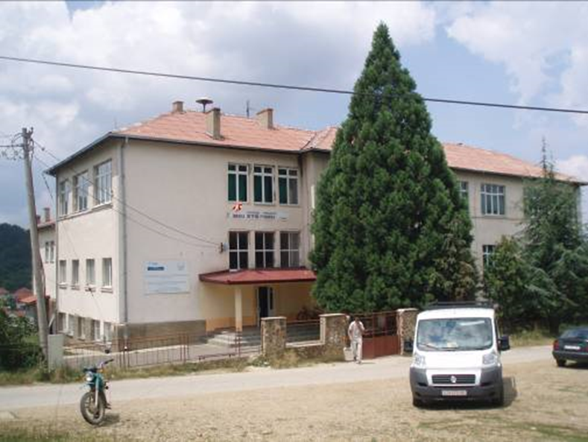
Example of heating system in Berovo, Macedonia
School supplied with woodchips by Private Forest Owners

Slide 17
Project details
School in village Dvorishte: Berovo
School area for heating: 560 m2
Annual energy consumption: 47.520 KWh
Previous school heating annually: 6.000 L diesel oil
Replaced with wood chips and new boiler
Energy value of wood chips: 3.5 KWh/kg
Wood chips weight required: 47.520 KWh * 3.5 = 13.600 kg
Average weight of wood chips, 30% moisture: 200 kg/m3
Wood chip quantity volume required: 70m3

Slide 18
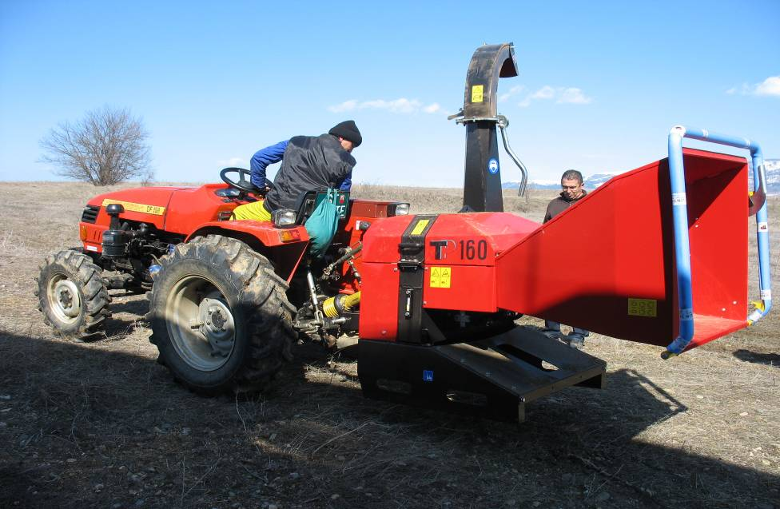
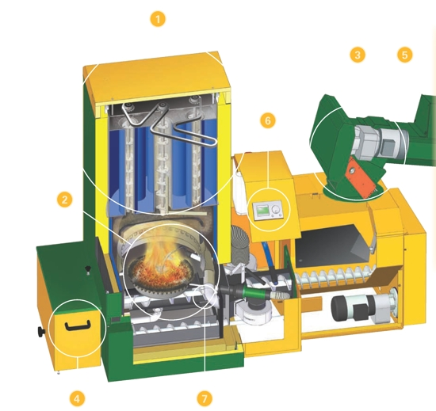
Equipment required
Wood chipper and boiler

Slide 19
Cost-benefit calculation for wood chips
Previous use of diesel oil: 6000 l * 1€ = 6.000 €
Wood chips (high price) 50 €/m³ * 70 m³ = 3.500 €
      (low price) 30 €/m³ = 2.100 €
Investments:
  Wood chipper: 8.000 – 9.000€,
  Boiler with installation: 17.000 €
Rate of return: 6-10 years

Slide 20
Kosovo
Renewable Energy Action Plan, 2011-20: RES targets (25% by 2020 for the use of RES in electricity, heat consumption and transport)
Energy sector:
98% of electricity is produced from lignite (two old, inefficient and heavily polluting lignite coal-­fired thermal power plants, Kosova A/B)
87% of households use wood for space heating
3.6% pellets, briquettes, other solid fuels and biofuel

Slide 21
Kosovo
Potential and challenges for use of biomass
Agriculture:
63% available biomass sources
Cereals and fodder crops – only 30% effectively available
No biogas plant operating
Forestry:
18% available biomass sources, 95% use firewood for household heating
Low conversion of firewood and residues into modern biomass fuels (briquettes/pellets)
Total forest area 44.7%
Over 90% illegal logging (with 53% in public forests)
Private forest, 38-76% legally produced firewood

Slide 22
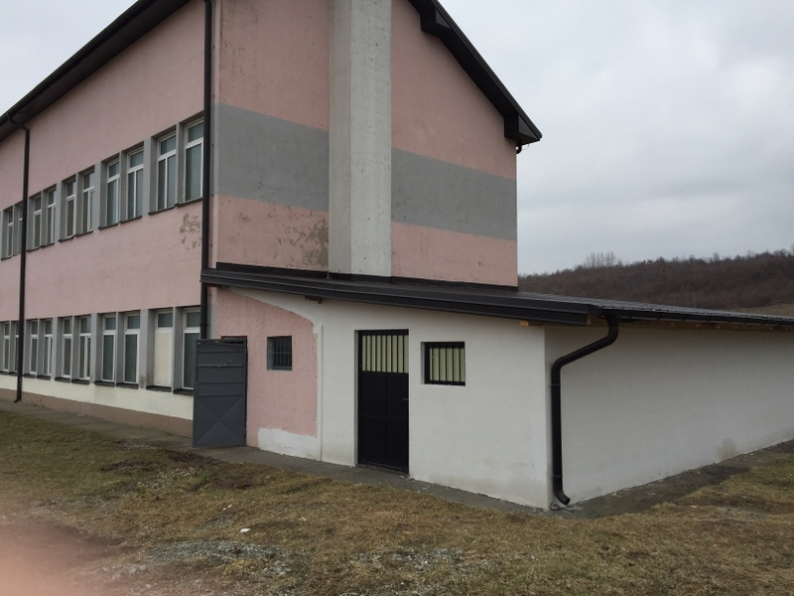
Kosovo – example
Innovative heating system in school, Djakovica

Slide 23
Project details
School in village: Dol, Djakovica
School area for heating: 942 m2
Previous heating system: diesel
Replaced with wood chips and new boiler
Private forest owners equipped with wood chipper
School supplied with woodchips by private forest owners
Wood mass only from forest rehabilitation

Slide 24
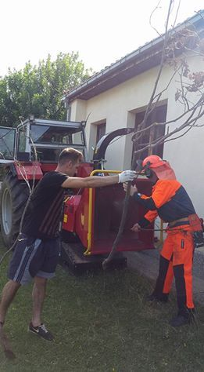
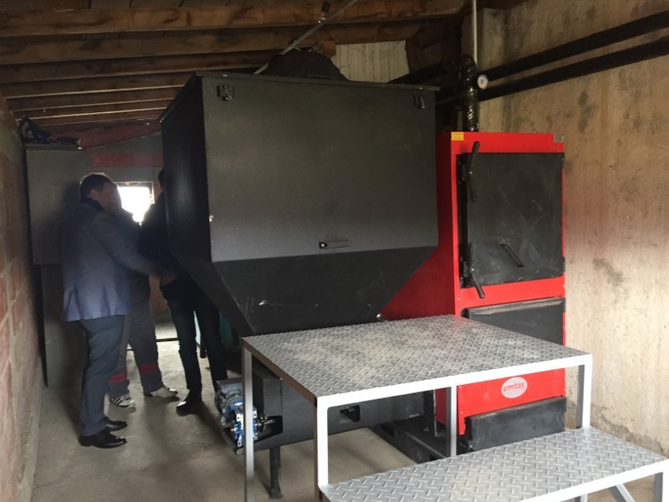
Equipment required - wood chipper and boiler

Slide 25
Cost benefit analysis
Biomass (wood chips) heating system 80m3 1600€
Firewood heating system 40m3 1600€
Coal heating system 27t 3510€
Diesel heating system 8000l 8000€

Slide 26
Wood biomass value chain
Local sustainable wood biomass
Wood waste from private forests
Members of a private forest owners association (PFOA) provide wood waste
PFOA is producing wood chips with chipper
PFOA is transporting wood chips to school
School is using wood chips for heating
Public private partnership (PPP) agreement between PFOA and municipality to supply wood chips to the school

Slide 27
CONCLUSION
Transitioning to renewables
Replacement of fossil fuels with renewable energy, particularly wood biomass, short rotation crops and bio-energy production
Benefits
Reduction of CO2 emission through substitution of fossils
Development of long-term cooperation through PPPs
Replication possibilities: private initiatives, PPPs, residential buildings
Raising awareness about the benefits of using wood biomass
Enhancement of services provided by national PFOA
Enhanced living conditions in rural areas
Development of the rural economy

Slide 28
Thank you for your attention.
Building a Greener Economic Environment
info@cnvp-eu.org www.cnvp-eu.org

